Slide 1
A Re-introduction to Web services
IN712 Web 3

Slide 2
What exactly is a web service?
In its simplest form, a web service is a framework for a conversation between two computers
A client sends request over the Internet and a server receives that request and returns a response
When a browser makes a request for a webpage, it receives HTML and other related content in the response
But when a client just asks for data and uses programmatically process the response, a web service has been used
API

Slide 3
Web Services Recap
Web services typically have very strict requirements for usage that are documented for developers
Modern web service communications are nearly always handled over HTTP
But the format of the message that are being sent and received can differ greatly
Web services are therefore, the great decouplers of modern computing.
The client doesn't understand how the server works and vice versa
They work together through a shared vocabulary

Slide 4
History of Web services
The concept of two computers communicating with each other to share business information, and speaking in a shared vocabulary with a strongly defined set of protocols, is not new
EDI (Electronic Data Interchange)
In the early 1990's a standard known as RPC, or Remote Procedure Call, emerged
RPC systems allow client computers to call functions, or subroutines, hosted by remote computers using syntax as similar as possible to the code they might use locally
Microsoft quickly followed up with their own flavor: MSRPC.
Followed by Microsoft's COM OLE architecture.
Also in the early 1990's, a competing standard named CORBA, for Common Object Request Broker Architecture, emerged
Java's RMI, for Remote Method Invocation, was an interface designed to communicate over the internet inter-ORB protocol (IIOP)

Slide 5
History of Web services
This very busy period in remote computing (1991-1996) saw the emergence and active use of nearly a dozen different standards.
Each with their own protocols, message formats and supported programming languages and operating systems.
They all had in common, a level of complexity that made them difficult to get started with, and difficult to use.

Slide 6
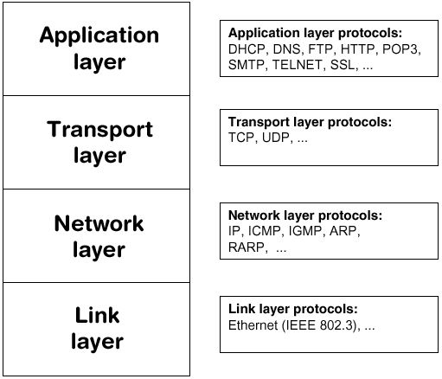
HTTP - Hypertext Transfer Protocol
The first definition HTTP occurred in 1997
The most popular transport protocol today
Used by web browsers and other client applications to communicate in real time over the worldwide web
HTTP is a simple text-based vocabulary that lets computers exchange requests and responses
A web service conversation over HTTP starts with a client computer forming and sending a request message
The server receives and processes the request by executing whatever actions are requested and then forms and sends back a response.
Other transport protocols
FTP, SMTP, POP

Slide 7
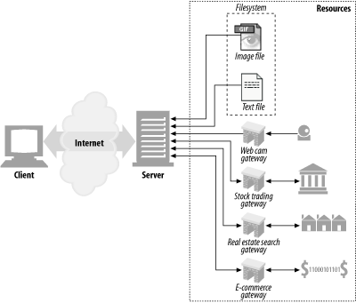
Web Resources

Slide 8
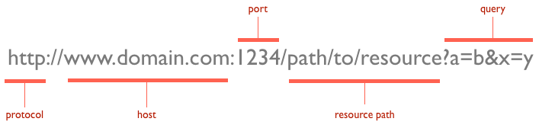
HTTP - URI

Slide 9
HTTP Methods
HTTP requests and responses follow a strict vocabulary. Each request is of a particular method or verb
GET: the client wants to retrieve some resource
HEAD: like GET but server returns only headers
POST: the client wants to add data to the server side repository
PUT: the client wants to update a resource in the server
DELETE: the client wants to delete a resource
OPTIONS: the client asks the server about its supported capabilities
TRACE: the client knows how its requests arrive to the server
Extension methods: not defined in the HTTP specification
These http methods don't map to those actions automatically. They have to be interpreted by the web service
Not all web services are sensitive to all http methods or verbs

Slide 10
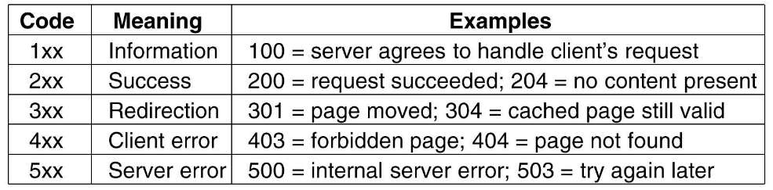
HTTP status codes

Slide 11
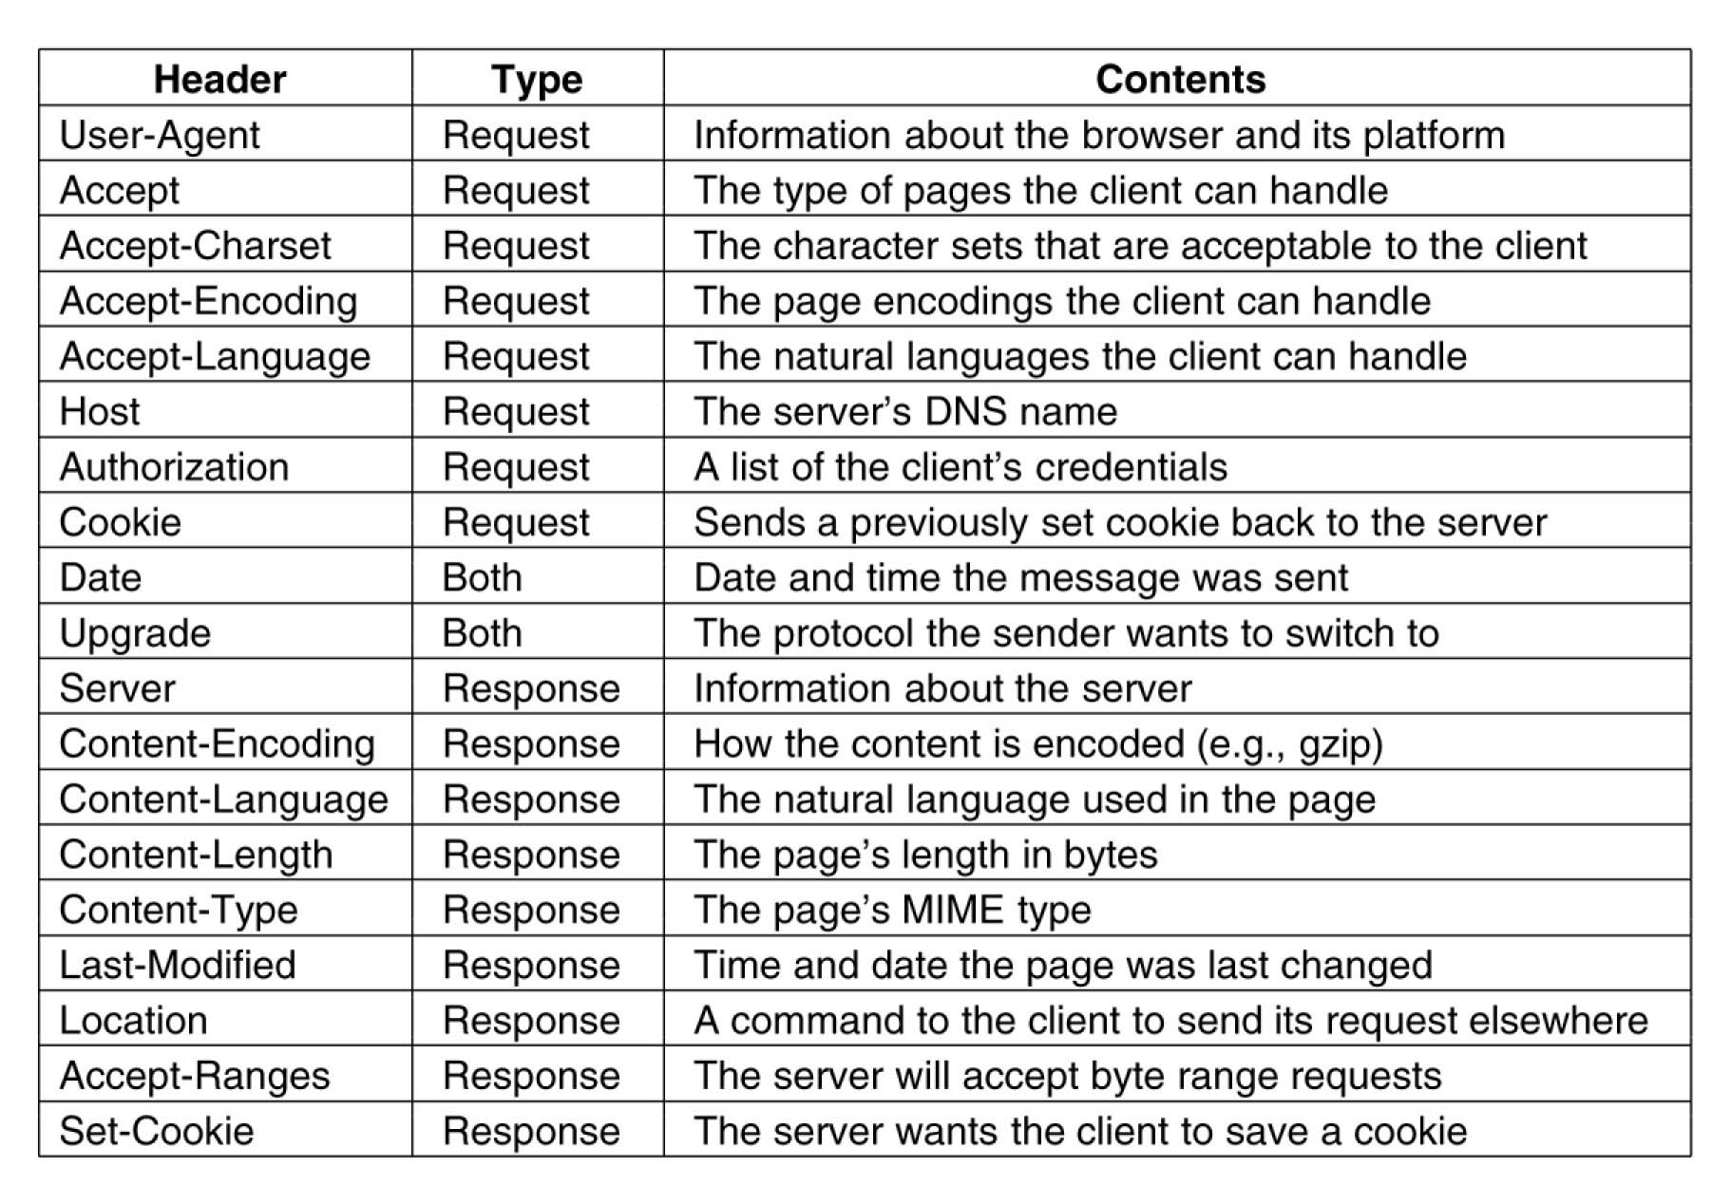
HTTP Headers

Slide 12
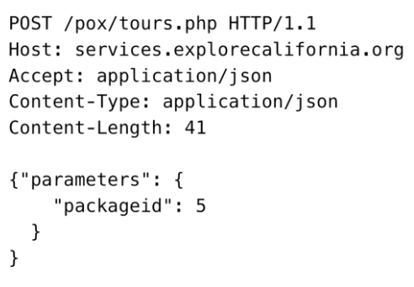
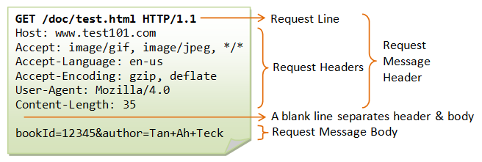
HTTP Request Syntax

Slide 13
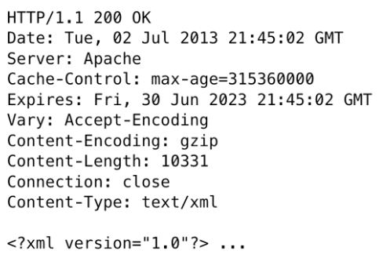
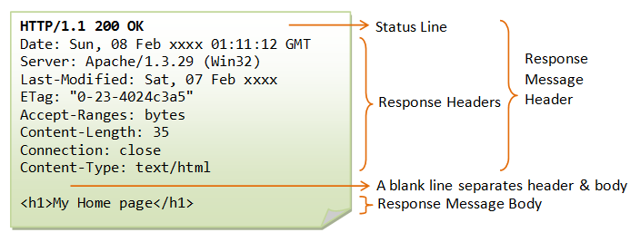
HTTP Response Syntax

Slide 14
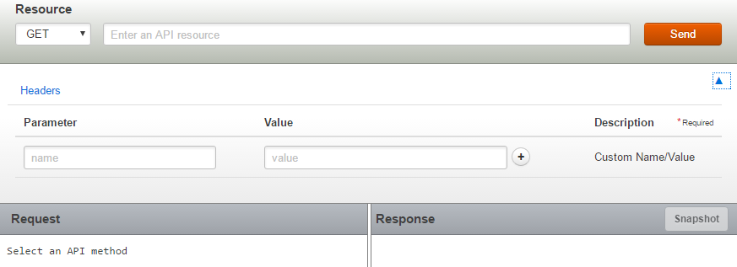
REST Console
Useful tool to study HTTP requests and response messages
https://apigee.com/console/others
Accept-Language
Sample URL: http://maps.googleapis.com/maps/api/geocode/xml?address=New%20York

Slide 15
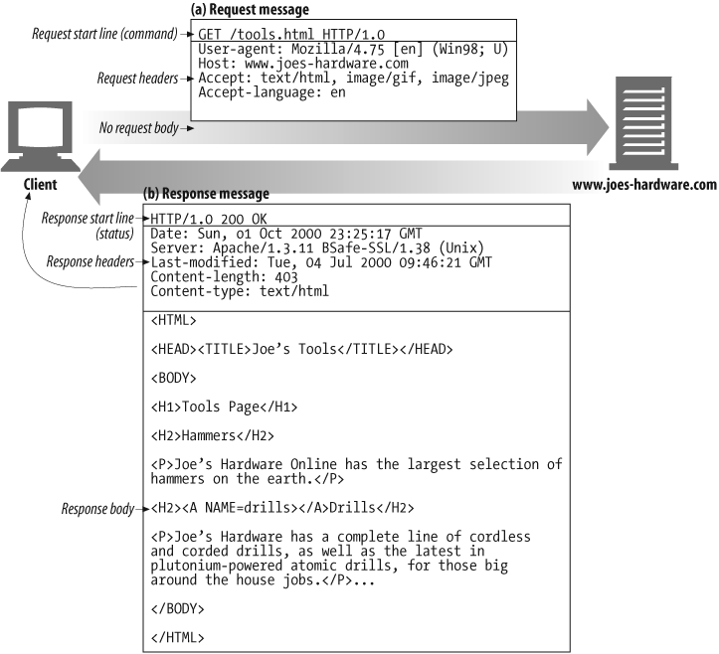
Example GET transaction

Slide 17
Message Formats: XML
In 1998, the world of web services was revolutionized with the introduction of XML or Extensible Markup
It's goals were simplicity, readability, and generality
Unlike EDI or the binary formats of some other systems, XML is plain text and when formatted as a high reticule set of nested tags, is easy to read for human eyes
XML was also ideal in many ways, for data exchange
Because it has strict formatting rules, you can easily validate whether a particular XML snippet properly represents expected data.
It quickly became one of the most common formats for web service messages.
Atom and RSS are some of the best known XML based languages used in today's web services.
But there're literally thousands of different XML languages designed to represent all sorts of data models.

Slide 18
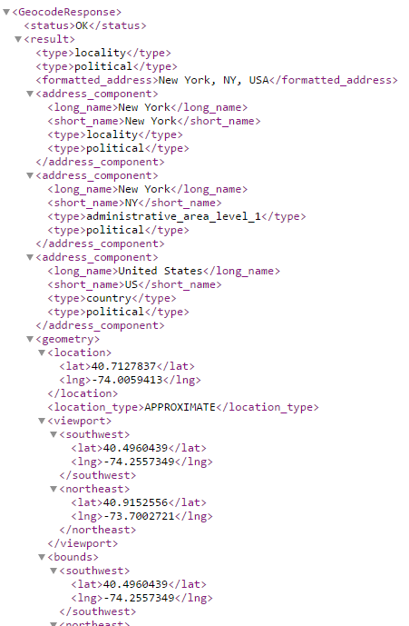
Message Formats: XML
http://maps.googleapis.com/maps/api/geocode/xml?address=New%20York

Slide 19
Message Formats: JSON
JSON (JavaScript Object Notation) is a lightweight data-interchange format.
It is easy for humans to read and write.
It is easy for machines to parse and generate.
JSON is a syntax for serializing objects, arrays, numbers, strings, booleans, and null
It is based upon JavaScript syntax but is distinct from it
JSON is built on two structures:
A collection of name/value pairs. In various languages, this is realized as an object, record, struct, dictionary, hash table, keyed list, or associative array
An ordered list of values. In most languages, this is realized as an array, vector, list, or sequence
These are universal data structures. Virtually all modern programming languages support them in one form or another. It makes sense that a data format that is interchangeable with programming languages also be based on these structures.

Slide 20
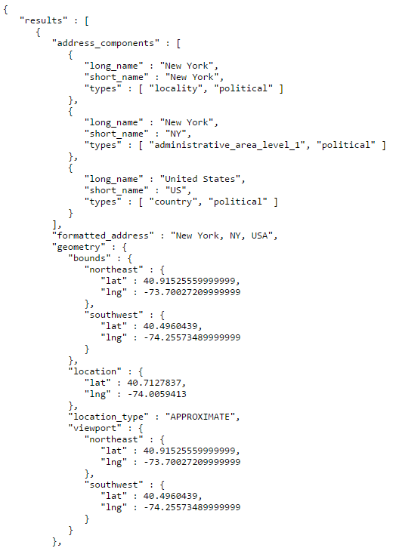
Message Formats: JSON
http://maps.googleapis.com/maps/api/geocode/json?address=New%20York

Slide 21
Message Formats: Other
Action Message Format or AMF
binary format that was originally created for Macromedia's Flash
HTML
it isn't particularly well suited for structure data but is sometimes used for it anyway
Comma or tab separated files
Arbitrary text formats that require custom parsers
Binary formats including
Spreadsheets
archive data bases
image files

Slide 23
Web Service Standards: SOAP
Strictly speaking a message format
An XML based markup language with a very specific set of tags, attributes and supported data types
The introduction of SOAP in the late 1990s triggered the broad spread use of web services in all sorts of applications.
It led to the new buzz phrase, Service Oriented Architecture or SOA
Developers who used SOAP based services, don't need to deal directly with the underlying XML messages. Instead they call functions, known as operations, that are defined by the service they're using
The resulting code in a client-side application can look almost exactly like a function they might call in their local client environment
The translation of outgoing requests and incoming responses is handled by the underlying SOAP library implementation.

Slide 24
Web Service Standards: SOAP
In the early 2000s, SOAP was the dominant web services standard
SOAP's major downside is in its verbocity. Its request and response messages are encoded in a plaint text XML with a lot of attributes and annotations
As a result, its messages simply require more text than slimmer message formats, such as JSON
Also, the engines that are required to do the creation and parsing of SOAP messages are of varying quality.
The developer has to trust the libraries to do the right thing, work efficiently and quickly and translate everything from XML to native data types and back again
For developers who like to know exactly what's happening at run-time this is all a little too high level

Slide 25
Using SOAP, a request looks like this:
Querying a phonebook application for the details of a given user:
<?xml version="1.0"?>
<soap:Envelope
xmlns:soap="http://www.w3.org/2001/12/soap-envelope" soap:encodingStyle="http://www.w3.org/2001/12/soap-encoding">
<soap:body pb="http://www.acme.com/phonebook">
<pb:GetUserDetails>
<pb:UserID>12345</pb:UserID>
</pb:GetUserDetails>
</soap:Body>
</soap:Envelope>

Slide 26
Web Service Standards: REST
Sometime in the mid 2000s much of the web services world started moving to what are known as REST (or RESTful) web services
The term REST stands for Representational State Transfer
But REST took a bit longer to gain traction in the computing world
REST requirements are lighter weight than those of SOAP, and only require that such services use simple HTTP request response messaging
REST is an architecture, not a specific web service messaging format, and it's wrapped around the concept of HTTP methods or verbs

Slide 27
Web Service Standards: REST
A GET request is different from a POST request
PUT and DELETE requests can also have their own meaning. REST services can exploit these differences. Translating them into specific server side actions
All you need is a client that's capable of forming and sending the requests, which are typically in the form of URIs (Uniform Resource Identifiers)
Unlike SOAP, RESTful services don't all use the same message format
One service might return data in a XML based language such as RSS or Atom.
Or in a custom XML language designed for a particular business process.
Or for the sake of speed and efficient use of bandwidth. It might encode it's data in JSON.
Or HTML

Slide 28
Web Service Standards: REST
Over the past half decade as developers have shifted their focus to building applications for mobile devices speed and message size have become critical factors
Mobile devices have less storage than desktop computers, and cell phone users pay by the megabyte for the bandwidth they consume.
Due to it's verbosity and resulting size, SOAP isn't well suited to the mobile world. Instead, web services using JSON message notation are increasingly popular

Slide 29
Using REST, a request looks like this:
Querying a phonebook application for the details of a given user:
GET /phonebook/UserDetails/12345 HTTP/1.1
Host: www.acme.com
Accept: application/xml

